Slide 1
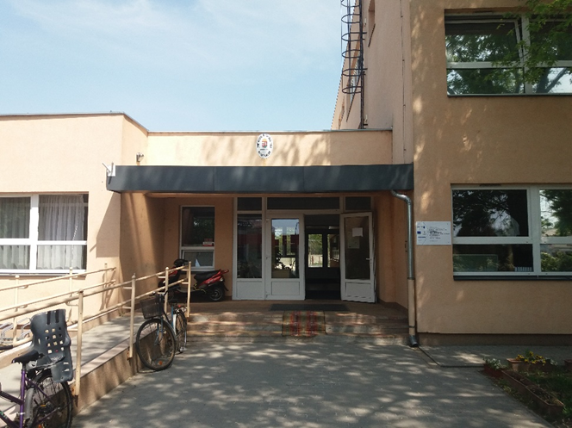
Szigethalmi Szent István Általános Iskola
Hungary

Slide 2
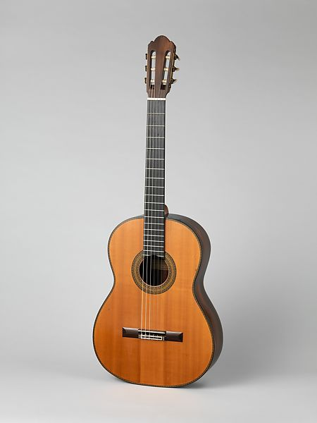
My name is Eliána Svajka
I was born in 2007
I live in Szigethalom, Hungary
I live with my family
My favorite animal is cat
In my free time I usually play my guitar or talk to my friends

Slide 3

My names is Nóra Réti
I was born in 2007
I live in a small town in Hungary
I live with my parents and my sisters
We have 2 dogs and 2 cats
In my free time I usually draw, or read something

Slide 4

I’m Patrik Kádár
I’m 14 years old.
I love to play video games, and talk with my friends online.
I don’t really have a hobby.
My favourite color is dark blue
I have 2 french bulldogs, and i love to play with them
And like to play volleyball at school.

Slide 5
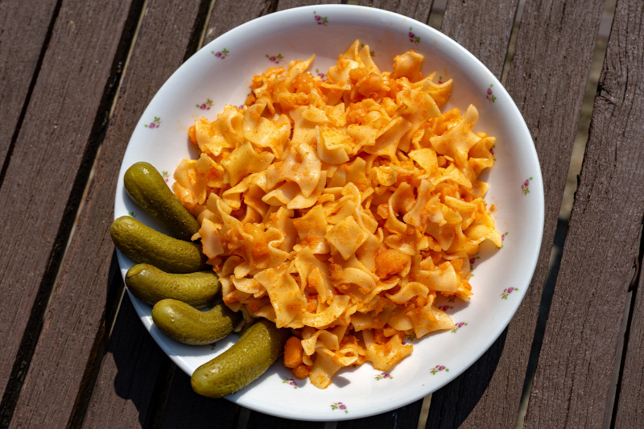
My name is Ujszászi Szabolcs
I’m 14 years old
I live in Szigethalom, Hungary
My favourite colour is brown
My favourite-favourite food is potato pasta
My favourite film is the Green Mile made in 1999
My hobbie is playing table tennis
My favourite animal is cat

