Slide 1


About me
My name is Laura
I am 13 years old
I live in small town called Szigethalom
I have two siblings
I love dancing

Slide 2

My name is Czingli Nóra
I live in a small town called Szigethalom
I am 13 years old
I play handball in the afternoons but I am really bad at it
I live with my parents and with my brother

Slide 3

My name is Zsófi
I am 14 years old
I live in a small town called Szigethalom
I have two siblings: a younger brother and older sister
I live with my family

Slide 4
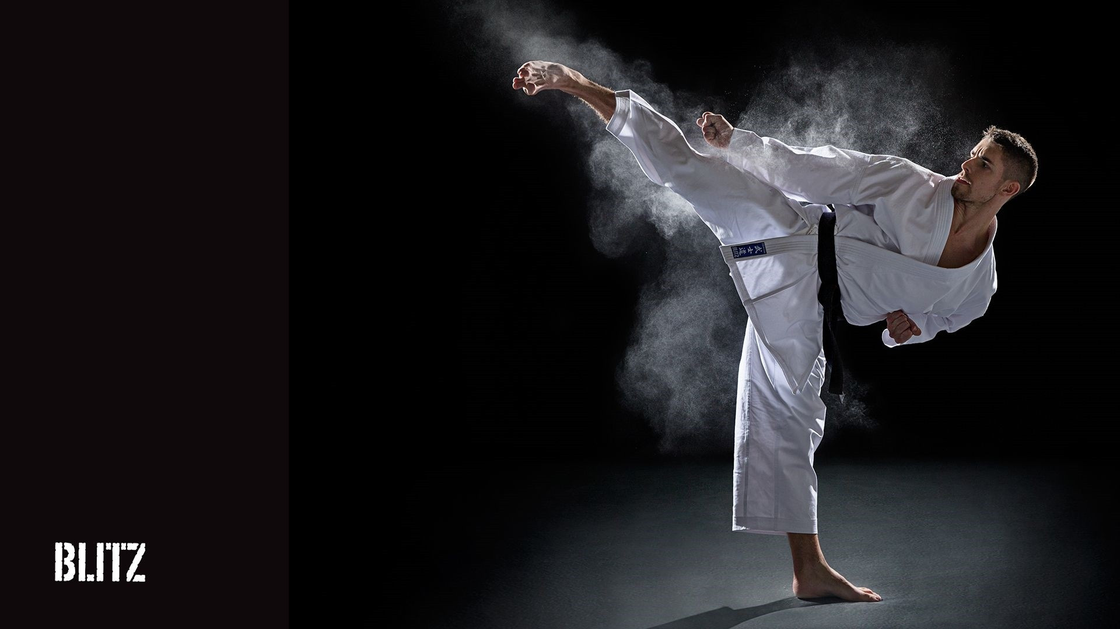
My name is László
I am fourteen
I have two siblings
I do karate
I have a dog, he is seven years old

