Slide 1




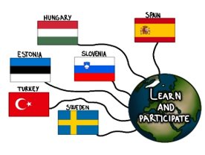

ERASMUS+
LEARN AND PARTICIPATE
Eksperience Students
Mobility for students
and teachers
Spain
15th – 21th May 2022
Vesna Ristova Petrova
Janja Lebar

Slide 2
ERASMUS Eksperience
Students Tara Kličič 9.B
Students, Zarja Kopriva 8. B

